Slide 1

Data Structures and Algorithms Instructor: Maira Sami
maira.sami@szabist.edu.pk
Campus 100
Room No. 101

Slide 2
LECTURE# 02 Algorithm Analysis

Slide 3
Data abstraction
Abstraction? Anything that hides details & provides only the essentials.
Abstract Data Type
An abstract data type(ADT) is a data type that is organized in such a way that the specification of the objects and the operations on the objects is separated from the representation of the objects and the implementation of the operations.
We know what is does, but not necessarily how it will do it.
Notes:
It is user defined data type
User define the value storage memory size , loc
Data and associated operations defined in it there is no implementation of data.

Slide 4
Abstract Data Type
A mathematical model of the data objects that make up a data type as well as the functions that operate on these objects.
An abstract data type (ADT) specifies behavior, but not implementation
It specifies the type of data stored and the operations that supports the data
Notes:
An implementation uses a particular low-level data type to implement the desired behavior.

Slide 5
ADTs
While designing ADTs, a designer has to deal with two types of questions:
(i) What values are in the domain? What operations can be performed on the values of a particular data type?
(ii) How is the data type represented? How are the operations implemented?

Slide 6
ADTs
ADTs specification answers the ‘what’ questions. Specification is written first.
ADTs implementation answers the ‘how’ questions. Done after specification.
Users & Implementers.
Users of an ADT need only know the specification …. no implementation details.← advantage
Programmer (Implementer) who implements ADT is concerned with specification, representation and implementation.

Slide 7
ADTs
Elements
Structure
Domain
Operations
User of an ADT
must know
only this
Specification
Implementer must
know all these.
Representation
Implementation

Slide 8
How to analyse an algorithm
First criteria to analyse any algorithm is ‘TIME’
Second is ‘SPACE’
Or
Algorithm complexity:
It is the function which gives running time and space requirements of an algorithm
Example (swap function algo)*

Slide 9
Counting the number of operations
There are four rules to count the operations:
Rule 1: for loops
The running time of a for loop is at most the running time of the statements inside the loop i.e times the number of iterations.
for( i = 0; i < n; i++)
sum = sum + i;
Find how many times each statement is executed.

Slide 10
for( i = 0; i < n; i++) // i = 0; executed only once: O(1)
// i < n; n + 1 times O(n)
// i++ n times O(n)
// total time of the loop heading:
// O(1) + O(n) + O(n) = O(n)
sum = sum + i; // executed n times, O(n)
The loop heading plus the loop body will give:
O(n) + O(n) = O(n).
Loop running time is: O(n)

Slide 11
Rule 2: Nested loops
The total running time is the running time of the inside statements times the product of the sizes of all the loops
sum = 0;
for( i = 0; i < n; i++)
for( j = 0; j < n; j++)
sum++;
Applying Rule 1 for the nested loop (the 'j' loop) we get O(n) for the body of the inner loop.
The outer loop runs n times, therefore the total time for the nested loops will be
O(n) * O(n) = O(n*n) = O(n2).

Slide 12
What happens if the inner loop does not start from 0?
sum = 0;
for( i = 0; i < n; i++)
for( j = i; j < n; j++)
sum++;
Here, the number of the times the inner loop is executed depends on the value of i:
i = 0, inner loop runs n times
i = 1, inner loop runs (n-1) times
i = 2, inner loop runs (n-2) times
...
i = n - 2, inner loop runs 2 times
i = n - 1, inner loop runs 1 (once)
Adding the right column, we get: ( 1 + 2 + … + n) = n*(n+1)/2 = O(n2)

Slide 13
Rule 3: Consecutive program fragments
The total running time is the maximum of the running time of the individual fragments
sum = 0;
for( i = 0; i < n; i++)
sum = sum + I;
sum = 0;
for( i = 0; i < n; i++)
for( j = 0; j < 2n; j++)
sum++;
The first loop runs in O(n) time, the second - O(n2) time, the maximum is O(n2)

Slide 14
Rule 4: If statement
if Condition
S1;
else
S2;
The running time is the maximum of the running times of S1 and S2.

Slide 15
Example:
Algorithm swap (a , b)
{
temp = a;
a = b;
b = temp ;
}
Time function:
F(n) = ???
Notes:
3

Slide 16
For space analysis :
We have 3 variables in program
A
B
Temp
So S (n)=??
Notes:
3

Slide 17
Frequency count method:
Algorithm Sum (A,n)
{
S=0;
For( i=0; i<n ;i++)
{
S=S+A[i];
}
Return S;
}

Slide 18
Algorithm complexity
Time complexity
F(n)=2n+3
O(n) → degree of polynomial/order
Space complexity
S(n)=n+3
O(n) → degree of polynomial/order

Slide 19
2.
Algorithm Add (A,B, n)
{
For (i=0; i<n; i++)
{
For (j=0; j<n; j++)
{
C[i,j]= A[i,j]+B[i,j];
}
}
}

Slide 20
Time complexity :
F(n)= 2n^2 +2n +1
O(n^2)
Space Complexity
S(n) = 3n^2 +3
O(n^2)

Slide 21
What is time and space complexity of following algorithm :
Algorithm Multiply (A,B, n)
{
For (i=0; i<n; i++)
{
For (j=0; j<n; j++)
{
C[i,j]= 0;
For (k=0; k<n ;k++)
{
C[i,j]=C[i,j]+A[i,k]*B[k,j];
}
}
}
}

Slide 22
Time complexity :
F(n)= 2n^3+3n^2+2n+1
O(n^3)
Space complexity
S(n)=3n^2+4
O(n^2)

Slide 23
Time complexity :
For (i=0; i<n ; i++)
{
Statements;
}
2. For (i=n ; i>0 ; i--)
{
Statements;
}
Find:
O(??)
Notes:
n

Slide 24
3. for(i=0; i<n ; i++)
{
for (j=0; j<n ; j++)
{
statement;
}
}
O(??)
4. for(i=0; i<n ; i=i+2)
{
statement;
}
Notes:
N2
n/2

Slide 25
5. For (i=0; i<n ; i=i*2)
{
statement;
}
O(log n)
6. for(i=n ; i>= 10 ; i=i/2)
{
statement;
}
Notes:
Log2n

Slide 26
summary
for(i=0; i<n ; i=i++) O(n)
for(i=0; i<n ; i=i+2) O(n)
for(i=n; i>1 ; i=i--) O(n)
for(i=1; i<n ; i=i*2) O(log₂ n)
for(i=1; i<n ; i=i*3) O(log₃ n)
for(i=n; i>1 ; i=i/2) O(log₂ n)

Slide 27
Types of Time function:
O(1)---------Constant function
O(log logn)--- double logarithmic
O(log n )------logarithmic function
O((logn)^k)----poly logarithmic
O(n)--------linear function
O(nlogn)---- log linear
O(n²)--------Quadratic function
O(n³)-------- cubic function
O(n^k)---- polynomial
O(2^{n})-------- Exponential
O(n!)--- factorial
Notes:
Increasing growth rate top to bottom

Slide 28
Compare class of functions 1<log n < √n <nlog n <n² <n³ ----< 2^{n} < 3^{n} ----< n^{n}
Table
Graph

Slide 29
ASYMTOTIC NOTATIONS
Asymptotic Notations are languages that allow us to analyze an algorithm's running time by identifying its behavior as the input size for the algorithm increases. This is also known as an algorithm's growth rate.
There are 3 types of asymptotic notations
O big-oh → upper bound
Ω big- omega → lower bound
Ø theta → average bound

Slide 30
Big –oh
It would be convenient to have a form of asymptotic notation that means "the running time grows at most this much, but it could grow more slowly." We use "big-O" notation for just such occasions.
Given functions f(n) and g(n), we say that f(n)is O(g(n)) if there are positive constant C and n such that
f(n) <= C*g(n) for n>=n₀

Slide 31
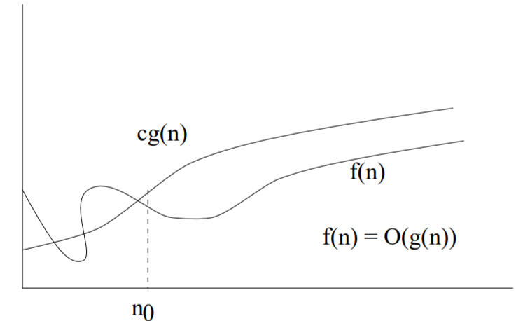
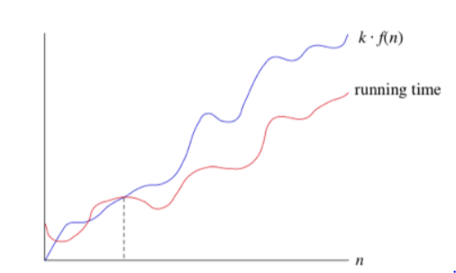

Slide 32
Exercise question
2n+3
2n³+2nlogn³ +5
3 logn +log logn
3¹⁰⁰
^{5/n}
Notes:
N
N3
Logn
1
1/n

Slide 33
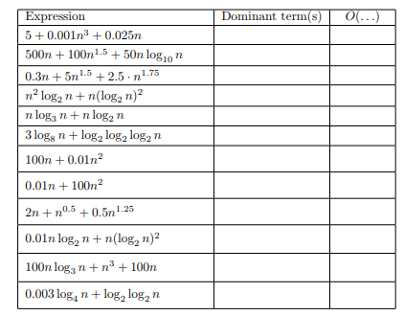
Solve this

Slide 34
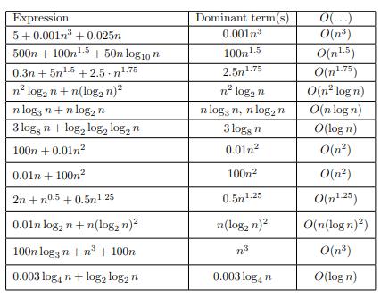

Slide 35
Big-Omega
Sometimes, we want to say that an algorithm takes at least a certain amount of time, without providing an upper bound. We use big-Ω notation; that's the Greek letter "omega."
Given functions f(n) and g(n), we say that f(n)is Ω(g(n)) if there are positive constant C and n such that
f(n) >= C*g(n) for n>=n₀
It provide lower bound of function

Slide 36
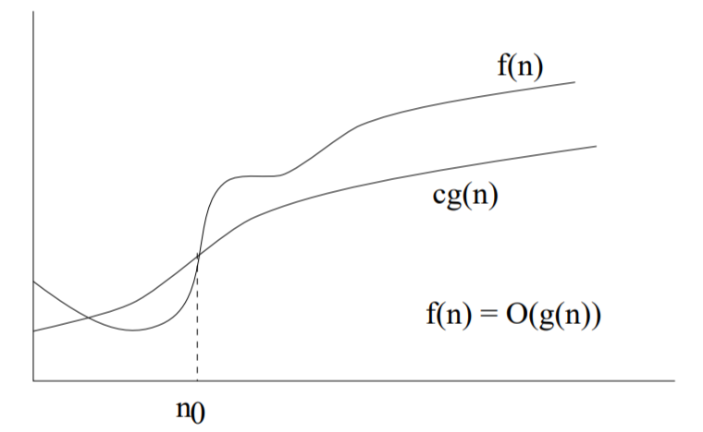
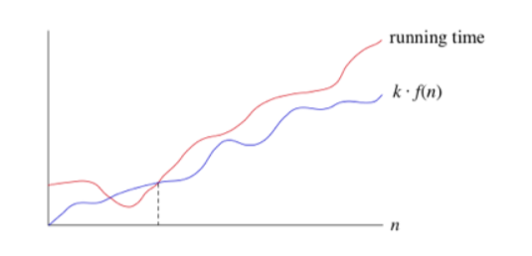

Slide 37
Theta notation
Given functions f(n) and g(n), we say that f(n)is Ø(g(n)) if there are positive constant C and n such that
C2*g(n) <= f(n) <= C1*g(n) for n>=n₀

Slide 38
exercise
1*n <= 2n+3 <= 5n theta ()
F(n) = 2n^2+3n +4 O()
F(n) = 2n^2+3n +4 omega() , theta()
F(n)= n^2 log n + n omega(),theta(), O()
F(n)= n! omega(),theta(), O()
F(n)= logn! omega(),theta(), O()
Notes:
N
N2
N2logn
1,nn

Slide 39
Properties of asymptotic notations
GENERAL PROPERTY
If f(n) is Og(n) then a*f(n) is Og(n)
Same for theta and omega notation

Slide 40
2. REFLEXIVE PROPERTY :
If f(n) is given that f(n)= O(f(n))
3. TRANSITIVE PROPERTY
If
f(n) is O(g(n)) and g(n) is O(h(n))
then
f(n)=O(h(n))

Slide 41
4.SYMMETRIC PROPERTY:
5. TRANSPOSE PROPERTY

Slide 42
6. if f(n) is Og(n) and f(n) is Ωg(n) then f(n) is Øg(n)
7. ADDITIVE PROPERTY
8. MULTIPLICATIVE PROPERTY

Slide 43
Comparison of function

Slide 44
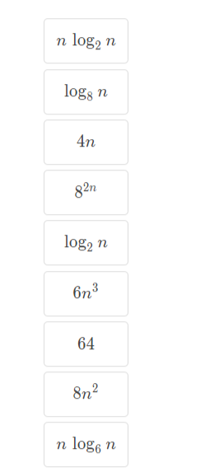
Practice problem : Rank these according to there growth rate

Slide 45
We have several different types of functions
Constant functions
Logarithmic functions
Linear functions
Linearithmic functions
Polynomial functions
Exponential functions

Slide 46
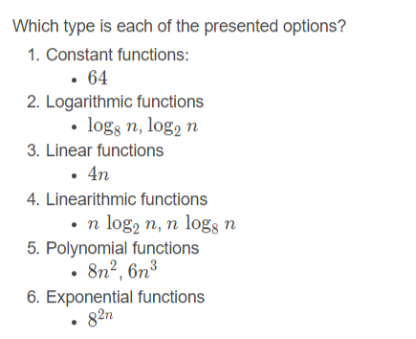

Slide 47
